Slide 1
Machine Learning DSECL ZG565
Dr. Monali Mavani
These slides were assembled, with grateful acknowledgement of Prof. Chetana BITS Pilani,Prof. many who made their course materials freely available online

Slide 2
Session Content
Bias Variance Decomposition
Decision Tree (Tom Mitchell Chapter 3)
Handling overfitting
Missing Values

Slide 3
Bias-Variance Decomposition

Slide 4
Expectation of a random variable
Let X be the random variable
E[X] = mean of a large number of observations of the random variable
The expectation of any constant c: E[c]=c​
E[ E[X] ]=E[X] because the expectation of a random variable is a constant.
E[X+Y]=E[X]+E[Y]​
E[cX] = E[c] E[X]= cE[X]​

Slide 5
Bias-Variance Tradeoff
Bias: difference between what you expect to learn and truth
Measures how well you expect to represent true solution
Decreases with more complex model
Variance: difference between what you expect to learn and what you learn from a particular dataset
Measures how sensitive learner is to specific dataset
Increases with more complex model
generalisation error = Bias² +Variance +Irreducible Error

Slide 6
Bias – Variance decomposition of error
E {( f (x) + ε − h (x)) }
2
D,ε
D
dataset and noise
learned from D
true function
noise
Fix test case x, then do this experiment:
Draw size n sample D=(x₁,y₁),….(x_{n},y_{n})
Train linear regressor h_{D} using D
Draw one test example (x, f(x)+ε)
Measure squared error of h_{D} on that example x
What’s the expected error?

Slide 7

Bias – Variance decomposition of error
Notation - to simplify this
f ≡ f (x) + ε
yˆ = yˆ_{D} ≡ h_{D} (x)
2
E_{D,ε} { ( f (x) + ε − h_{D} (x))
}
dataset and noise
true function
learned from D
noise

Slide 8
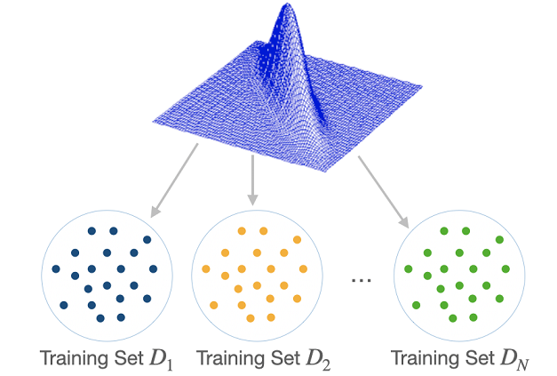
Bias – Variance decomposition of error
h ≡ E_{D}{h_{D} (x)}
long-term expectation of learner’s prediction on this x averaged over many data sets D

Slide 9
Bias – Variance decomposition of error
h=E {yˆ }
D D
E_{D,ε}{ ( f − yˆ )² }
= E { ([ f − h] +[h − yˆ ])² }
yˆ = yˆ
≡ h (x)
= E { [ f − h]² +[h − yˆ ]² + 2[ f − h][h − yˆ ] }
= E { [ f − h]² +[h − yˆ ]² + 2[ f h − f yˆ − h² + h yˆ ] }
D D
f ≡ f (x) + ε
= E[( f − h)² ] + E[(h − yˆ)² ] + 2 (E[ fh] − E[ fyˆ] − E[h² ] + E[hyˆ])

Slide 10
Bias – Variance decomposition of error
E_{D,ε}{ ( f − yˆ )² }= E[( f − h)² ] + E[(h − yˆ )² ]
h ≡ E {h (x)}
D D
yˆ = yˆ_{D} ≡ h_{D} (x)
f ≡ f (x) + ε
BIAS²
Squared difference between best possible prediction for x, f(x), and our “long-term” expectation for what the learner will do if we averaged over many
VARIANCE
Squared difference btwn our long- term expectation for the learners performance, E_{D}[h_{D}(x)], and what we expect in a representative run on a dataset D (hat y)
datasets D, E_{D}[h_{D}(x)]
13

Slide 11
Decision trees
Decision Trees is one of the most widely used and practical methods of classification
Method for approximating discrete-valued functions
Learned functions are represented as decision trees (or if-then-else rules)
Expressive hypotheses space

Slide 12
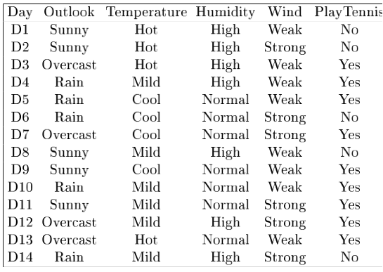
Example

Slide 13
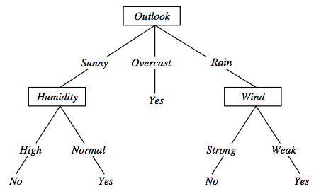
Decision tree representation (PlayTennis)
⟨Outlook=Sunny, Temp=Hot, Humidity=High, Wind=Strong⟩ No

Slide 14
Dealing with continuous-valued attributes
If features are continuous, internal nodes can test the value of a feature against a threshold

Slide 15
Dealing with continuous-valued attributes
Given a continuous-valued attribute A, dynamically create a new attribute A_{c}
A_{c} = True if A < c, False otherwise
How to determine threshold value c ?
Example. Temperature in the PlayTennis example
Sort the examples according to Temperature
Temperature 40 48 | 60 72 80 | 90
PlayTennis No No 54 Yes Yes Yes 85 No
Determine candidate thresholds by averaging consecutive values where there is a change in classification:
(48+60)/2=54 and (80+90)/2=85

Slide 16
Problem Setting
Set of possible instances X
each instance x in X is a feature vector
e.g., <Humidity=low, Wind=weak, Outlook=rain, Temp=hot>
Unknown target function f : X -> Y
Y is discrete valued
Set of function hypotheses H={ h | h : X->Y }
each hypothesis h is a decision tree
trees sorts x to leaf, which assigns y

Slide 17
Decision Tree Induced Partition
Slide credit : Eric Eaton

Slide 18
Decision Tree – Decision Boundary
• Decision trees divide the feature space into axis parallel (hyper-)rectangles
• Each rectangular region is labeled with one label
– or a probability distribution over labels

Slide 19
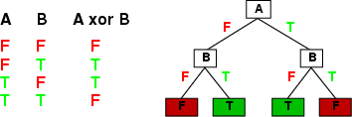
Expressiveness
Decision trees can represent any boolean function of the input attributes
Truth table row → path to leaf
In the worst case, the tree will require exponentially many nodes
Slide credit : Eric Eaton

Slide 20
Number of Distinct Decision Trees
How many distinct decision trees with 10 Boolean attributes? = number of Boolean functions with 10 propositional symbols
Input features Output
0 0 0 0 0 0 0 0 0 0 0/1
0 0 0 0 0 0 0 0 0 1 0/1
0 0 0 0 0 0 0 0 1 0 0/1
0 0 0 0 0 0 0 1 0 0 0/1
…
1 1 1 1 1 1 1 1 1 1 0/1
How many entries does this table have?
2¹⁰
So how many Boolean functions
with 10 Boolean attributes are there,
given that each entry can be 0/1?
= 2²¹⁰
Slide credit : Eric Eaton

Slide 21
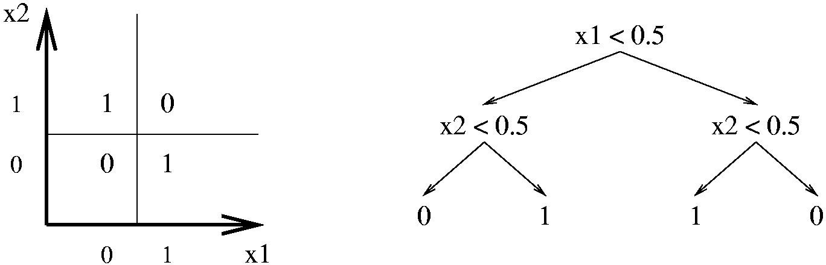
Expressiveness
Decision trees have a variable-sized hypothesis space
As the #nodes (or depth) increases, the hypothesis space grows
Depth 1 (“decision stump”): can represent any boolean function of one feature
Depth 2: any boolean fn of two features; some involving three features (e.g., (x1 ^ x2) _ (¬ x1 ^ ¬ x3) )
Based on slide by Pedro Domingos

Slide 22
Decision trees expressivity
Decision trees represent a disjunction of conjunctions on constraints on the value of attributes:
(Outlook = Sunny ∧ Humidity = Normal) ∨
(Outlook = Overcast) ∨
(Outlook = Rain ∧ Wind = Weak)

Slide 23
Measure of Information
It rained heavily in Shillong yesterday
There was a heavy rainfall in Rajasthan last night.
The amount of information (surprise element) conveyed by a message is inversely proportional to its probability of occurrence. That is
The mathematical operator satisfies above properties is the logarithmic operator.
19 December 2021

Slide 24
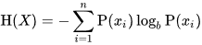
Entropy
Entropy of discrete random variable X={x₁, x₂…x_{n}}
since: log₂(1/P(event))= -log₂P(event)
As uncertainty increases, entropy increases
Entropy across all values
Entropy measures the amount of information in a random variable

Slide 25
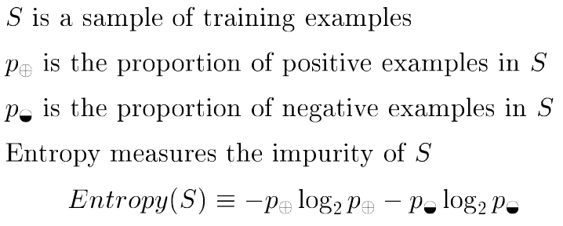
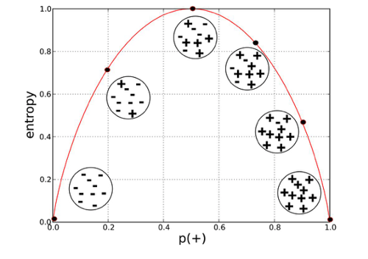
Entropy in general
H(X) = – Σ p_{i} log₂ p_{i} = Σ p_{i} log₂ 1/ p_{i} X = {i, …, c}
i=1 i=1
for classification in c classes
Inage credit : https://towardsdatascience.com/entropy-how-decision-trees-make-decisions-2946b9c18c8

Slide 26
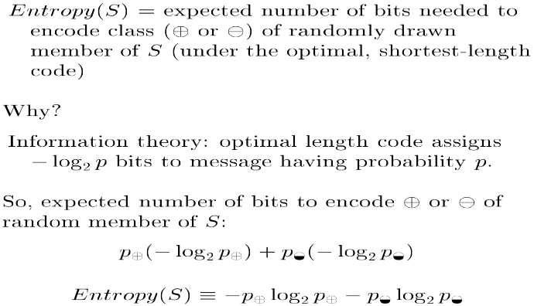
Entropy in Information Theory

Slide 27
Entropy in binary classification
Note: the log of a number < 1 is negative, 0 ≤ p ≤ 1, 0 ≤ entropy ≤ 1
Example:
https://www.easycalculation.com/log-base2-calculator.php

Slide 28
Information gain as entropy reduction
Information Gain (also called mutual information) between input attribute A and target variable
Information gain is the expected reduction in entropy caused by partitioning the examples on an attribute.
The higher the information gain the more effective the attribute in classifying training data.
Expected reduction in entropy knowing A
Values(A) is the set of all possible values for attribute A, and S_{v} is the subset of S for which attribute A has value v

Slide 29
Example
- Information gain due to knowing Wind

Slide 30
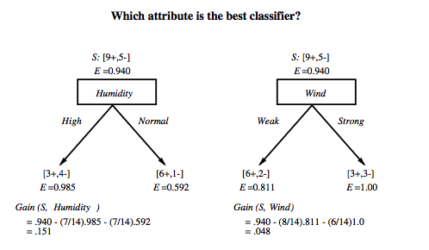
Which attribute is the best classifier?

Slide 31
First step: which attribute to test at the root?
Which attribute should be tested at the root?
Gain(S, Outlook) = 0.246
Gain(S, Humidity) = 0.151
Gain(S, Wind) = 0.084
Gain(S, Temperature) = 0.029
Outlook provides the best prediction for the target
Lets grow the tree:
add to the tree a successor for each possible value of Outlook
partition the training samples according to the value of Outlook

Slide 32
Example

Slide 33
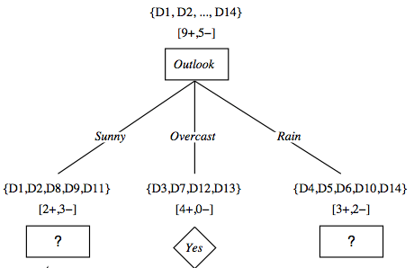
After first step

Slide 35
Second step
Working on Outlook=Sunny node:
Gain(S_{Sunny}, Humidity) = 0.970 − 3/5 × 0.0 − 2/5 × 0.0 = 0.970
Gain(S_{Sunny}, Wind) = 0.970 − 2/5 × 1.0 − 3.5 × 0.918 = 0 .014
Gain(S_{Sunny}, Temp.) = 0.970 − 2/5 × 0.0 − 2/5 × 1.0 − 1/5 × 0.0 = 0.570
Humidity provides the best prediction for the target
Lets grow the tree:
add to the tree a successor for each possible value of Humidity
partition the training samples according to the value of Humidity

Slide 36
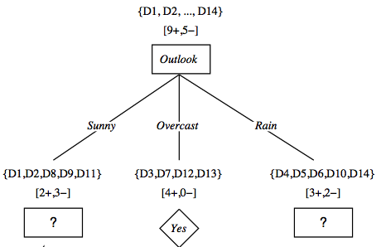
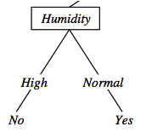
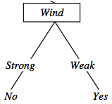
Second and third steps
{D1, D2, D8}
No
{D9, D11}
Yes
{D4, D5, D10}
Yes
{D6, D14}
No

Slide 37
ID3: algorithm
ID3(X, T, Attrs) X: training examples:
T: target attribute (e.g. PlayTennis),
Attrs: other attributes, initially all attributes
Create Root node
If all X's are +, return Root with class +
If all X's are –, return Root with class –
If Attrs is empty return Root with class most common value of T in X
else
A ← best attribute; decision attribute for Root ← A
For each possible value v_{i} of A:
- add a new branch below Root, for test A = v_{i}
- X_{i} ← subset of X with A = v_{i}
- If X_{i} is empty then add a new leaf with class the most common value of T in X
else add the subtree generated by ID3(X_{i}, T, Attrs − {A})
return Root

Slide 38
ID3: algorithm
Each instance attribute is evaluated using a statistical test to determine how well it alone classifies the training examples.
The best attribute is selected and used as the test at the root node of the tree.
A descendant of the root node is then created for each possible value of this attribute.
Training examples are sorted to the appropriate descendant node.
The entire process is then repeated using the training examples associated with each descendant node to select the best attribute to test at that point in the tree.
This forms a greedy search for an acceptable decision tree, in which the algorithm never backtracks to reconsider earlier choices.

Slide 39
Prefer shorter hypotheses: Occam's razor
Why prefer shorter hypotheses?
Arguments in favor:
There are fewer short hypotheses than long ones
If a short hypothesis fits data unlikely to be a coincidence
Elegance and aesthetics
Arguments against:
Not every short hypothesis is a reasonable one.
Occam's razor says that when presented with competing hypotheses that make the same predictions, one should select the solution which is simple"

Slide 40
Issues in decision trees learning
Overfitting
Reduced error pruning
Rule post-pruning
Extensions
Continuous valued attributes
Handling training examples with missing attribute values

Slide 41
Example
D15 Sunny Hot Normal Strong No

Slide 42
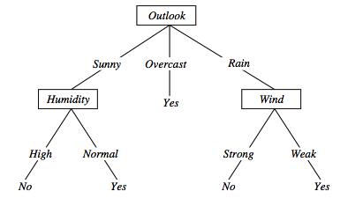
Overfitting in decision trees
⟨Outlook=Sunny, Temp=Hot, Humidity=Normal, Wind=Strong, PlayTennis=No ⟩
New noisy example causes splitting of second leaf node.

Slide 43
Overfitting in decision trees

Slide 44
Avoid overfitting in Decision Trees
Two strategies:
Stop growing the tree earlier , before perfect classification
Allow the tree to overfit the data, and then post-prune the tree
Training and validation set
split the training in two parts (training and validation) and use validation to assess the utility of post-pruning
Reduced error pruning
Rule post pruning

Slide 45
Reduced-error pruning
Each node is a candidate for pruning
Pruning consists in removing a subtree rooted in a node: the node becomes a leaf and is assigned the most common classification
Nodes are removed only if the resulting tree performs no worse on the validation set.
Nodes are pruned iteratively: at each iteration the node whose removal most increases accuracy on the validation set is pruned.
Pruning stops when no pruning increases accuracy

Slide 46
Effect of Reduced-error pruning

Slide 47
Decision Tree as set of rules

Slide 48
Rule post-pruning
Create the decision tree from the training set
Convert the tree into an equivalent set of rules
Each path corresponds to a rule
Each node along a path corresponds to a pre-condition
Each leaf classification to the post-condition
Prune (generalize) each rule by removing those preconditions whose removal improves accuracy …
… over validation set
Sort the rules in estimated order of accuracy, and consider them in sequence when classifying new instances

Slide 49
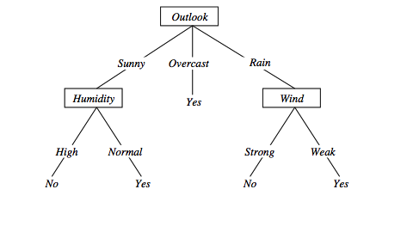
Converting to rules
(Outlook=Sunny)∧(Humidity=High) ⇒ (PlayTennis=No)

Slide 50
Rule Post-Pruning
Convert tree to rules (one for each path from root to a leaf)
For each antecedent in a rule, remove it if error rate on validation set does not decrease
Sort final rule set by accuracy
Compare first rule to:
Outlook=sunny->No
Humidity=high->No
Calculate accuracy of 3 rules
based on validation set and
pick best version.
Outlook=sunny ^ humidity=high -> No
Outlook=sunny ^ humidity=normal -> Yes
Outlook=overcast -> Yes
Outlook=rain ^ wind=strong -> No
Outlook=rain ^ wind=weak -> Yes

Slide 51
Why converting to rules?
Each distinct path produces a different rule: a condition removal may be based on a local (contextual) criterion. Node pruning is global and affects all the rules
Provides flexibility of not removing entire node
In rule form, tests are not ordered and there is no book-keeping involved when conditions (nodes) are removed
Converting to rules improves readability for humans

Slide 52
Problems with information gain
Natural bias of information gain: it favors attributes with many possible values.
Consider the attribute Date in the PlayTennis example.
Date would have the highest information gain since it perfectly separates the training data.
It would be selected at the root resulting in a very broad tree
Very good on the training, this tree would perform poorly in predicting unknown instances. Overfitting.
The problem is that the partition is too specific, too many small classes are generated.
We need to look at alternative measures …

Slide 53
An alternative measure: gain ratio
where S1 through S, are the c subsets of examples resulting from partitioning S by the c-valued attribute A.
SplitInformation measures the entropy of S with respect to the values of A. The more uniformly dispersed the data the higher it is.
GainRatio penalizes attributes that split examples in many small classes such as Date by incorporating split information.
Let |S |=n, Date splits examples in n classes
SplitInformation(S, Date)= −[(1/n log₂ 1/n)+…+ (1/n log₂ 1/n)]= −log₂1/n =log₂n
Compare with A, which splits data in two even classes:
SplitInformation(S, A)= − [(1/2 log₂1/2)+ (1/2 log₂1/2) ]= − [− 1/2 −1/2]=1

Slide 54
Handling missing values training data
How to cope with the problem that the value of some attribute may be missing?
The strategy: use other examples to guess attribute
Assign the value that is most common among the training examples at the node
Assign a probability to each value, based on frequencies, and assign values to missing attribute, according to this probability distribution

Slide 55
Decision Tree
Advantages:
Extremely fast at classifying unknown records
Easy to interpret for small-sized trees
robust to errors in training dataset
Can be used even with missing values in the dataset.
Disadvantages:
Space of possible decision trees is exponentially large.
Greedy approaches are often unable to find the best tree.
Each decision boundary involves only a single attribute

Slide 56
Applications
Suited for following classification problems:
Applications whose Instances are represented by attribute-value pairs.
The target function has discrete output values
Disjunctive descriptions may be required
The training data may contain missing attribute values
Real world applications
Biomedical applications
Manufacturing
Banking sector
Make-Buy decisions

Slide 57
Good References
Decision Tree
https://www.youtube.com/watch?v=eKD5gxPPeY0&list=PLBv09BD7ez_4temBw7vLA19p3tdQH6FYO&index=1
Overfitting
https://www.youtube.com/watch?time_continue=1&v=t56Nid85Thg
https://www.youtube.com/watch?v=y6SpA2Wuyt8

